Slide 1
IFAS
Integrated Flood Analysis System
Distributed by ICHARM (PWRI – JAPAN) since 2009
Rainfall – Runoff Model (Hydrological Model)
3 Versions
IFAS 1.2
IFAS 1.3
IFAS 2.0 (latest June 2014)

Slide 2
IFAS

Slide 3
IFAS
Input
Elevation Data (DEM)
Land Use Data
Rainfall Data
Basin Data

Slide 4
IFAS
Condition
Project Information Manager
Basin Data Manager
Rainfall Data Manager
Parameter Manager
Dam Control Manager
Simulation Manager
Result Viewer
KML Exporter
Input
Simulation and Output

Slide 5
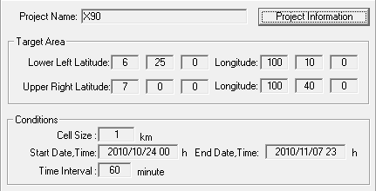
Project Information Manager
Cell Size 1 ตารางกิโลเมตร
Start-End Date, Time
- hourly (0 h – _ h)
- daily (0 h – 23 h)
Time Interval
- hourly 60 minute
- daily 1,440 minute
X.90 | ละติจูด | ลองจิจูด
มุมล่างซ้าย | 6 deg, 25 min | 100 deg, 10 min
มุมบนขวา | 7 deg, 0 min | 100 deg, 40 min

Slide 6
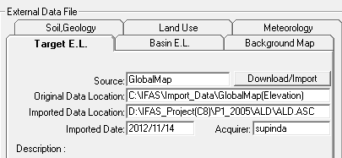
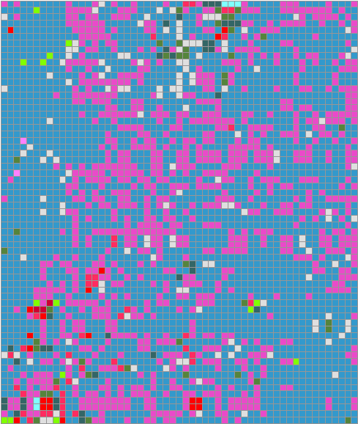
Project Information Manager
Target Elevation
- GlobalMap (Elevation)
Land Use
- GlobalMap (Land Cover)

Slide 7
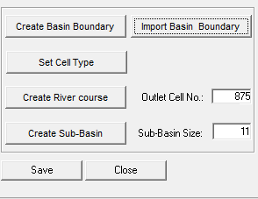
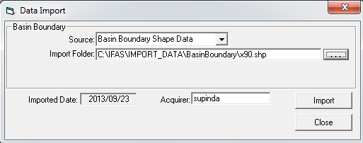
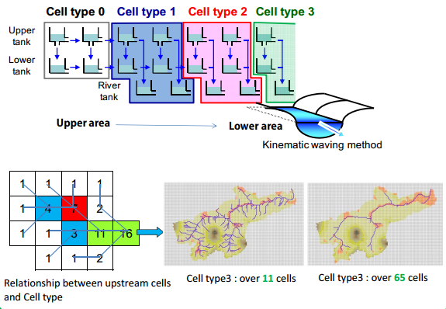
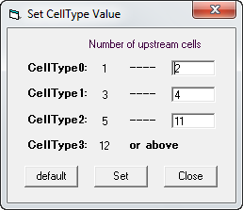
Basin Data Manager

Slide 8
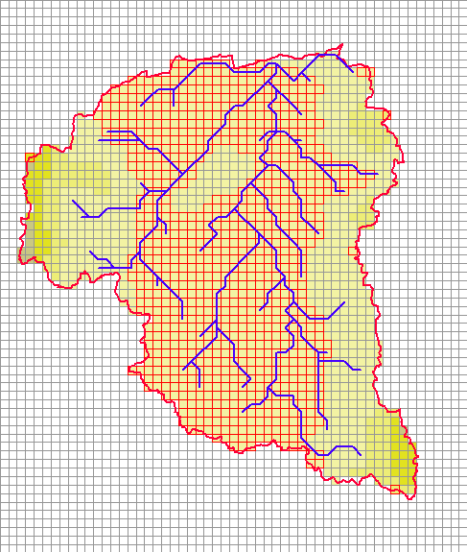
Basin Data Manager

Slide 9
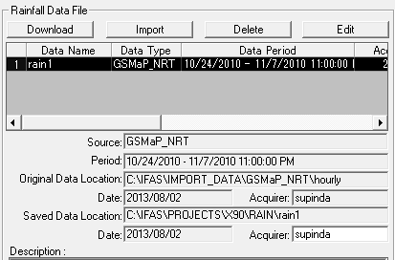
Rainfall Data Manager
Satellite Rainfall
GSMaP (0.1 degree = 10 x 10 km)
Past time – GSMaP MVK
Present – GSMaP NRT
TRMM (0.25 degree = 25 x 25 km)
Past time – 3B42RT V5
Present – 3B42RT V6
Ground-based Rainfall
CSV File
Thiessen Method
Time Difference
Download
Import
Edit

Slide 10
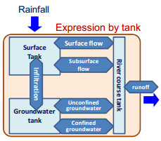
Parameter Manager
3 Parameter Set
- Surface Parameter (Surface Tank)
- Aquifer Parameter (Groundwater Tank)
- River Course Parameter (River Course Tank)

Slide 11
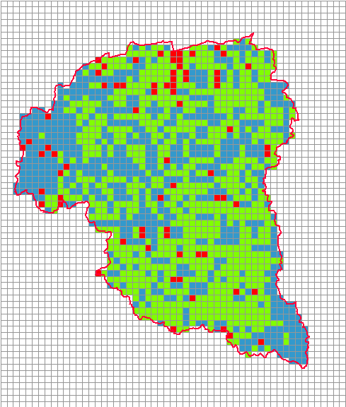
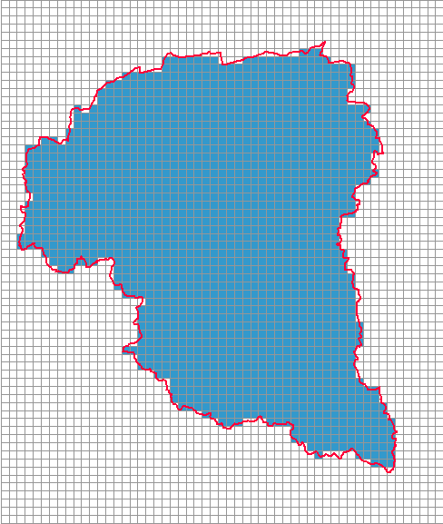
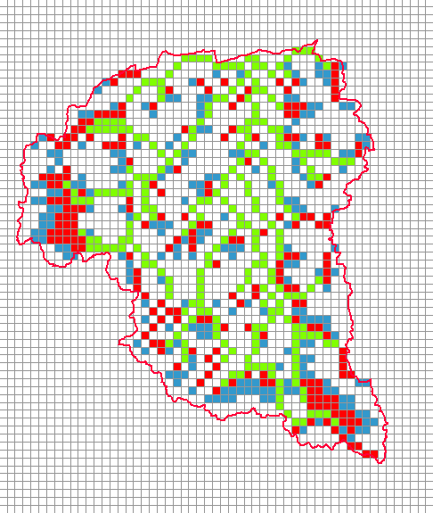
Parameter Manager

Slide 12
Parameter Manager
Surface Parameter
No | Parameter | Definition | Unit
1 | SKF | Final infiltration capacity | cm/s
2 | HFMXD | Maximum Storage height | m
3 | HFMND | Rapid intermediate flow Height where occurs | m
4 | HFOD | Height where ground infiltration occurs | m
5 | SNF | Surface roughness coefficient | m^{-1/3}/s
6 | FALFX | Rapid intermediate flow Regulation coefficient
7 | HIFD | Initial storage height | m
 | ป่าไม้
 | ไม้พุ่ม ต้นไม้ประปราย
 | เกษตรกรรม
 | ที่อยู่อาศัย
 | แหล่งน้ำ
HFMXD > HFMND > HFOD

Slide 13
Parameter Manager
Aquifer Parameter
No | Parameter | Definition | Unit
1 | AUD | Slow intermediate flow Regulation coefficient | (1/mm/day)^{1/2}
2 | AGD | Base flow coefficient | 1/day
3 | HCGD | Storage height where the slow intermediate flow occurs | m
4 | HIGD | Initial storage height | m
HCGD ≥ HIGD

Slide 14
Parameter Manager
River Course Parameter
No | Parameter | Definition | Unit
1 | RBW | Constant of the Resume Law: c
2 | RBS | Constant of the Resume Law: s
3 | RNS | Manning’s roughness coefficient | m^{-1/3}/s
4 | RRID | Initial water table of river channel | m
5 | RGWD | Infiltration of aquifer tank | 1/day
6-10 |  | Coefficient of cross shape
 | Range 3-4
 | Range 5-64
 | > 65
Number of cell type

Slide 15
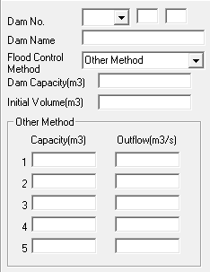
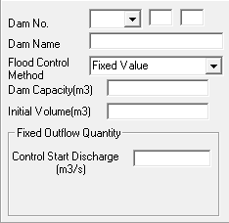
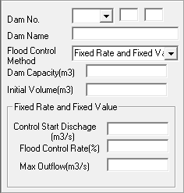
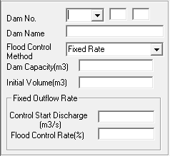
Dam Control Manager
4 Method
- Fixed Rate
- Fixed Value
- Fixed Rate and Fix Value
- Other Method

Slide 16
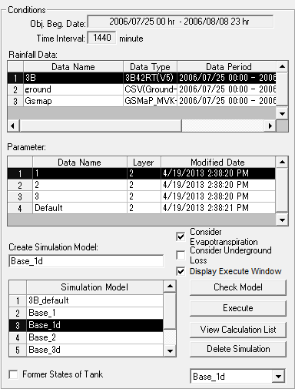
Simulation Manager
จับคู่ข้อมูลน้ำฝนกับค่า parameter เพื่อสร้างแบบจำลอง (1 คู่ / simulation)
การ calibrate ให้ปรับที่ค่า parameter

Slide 17
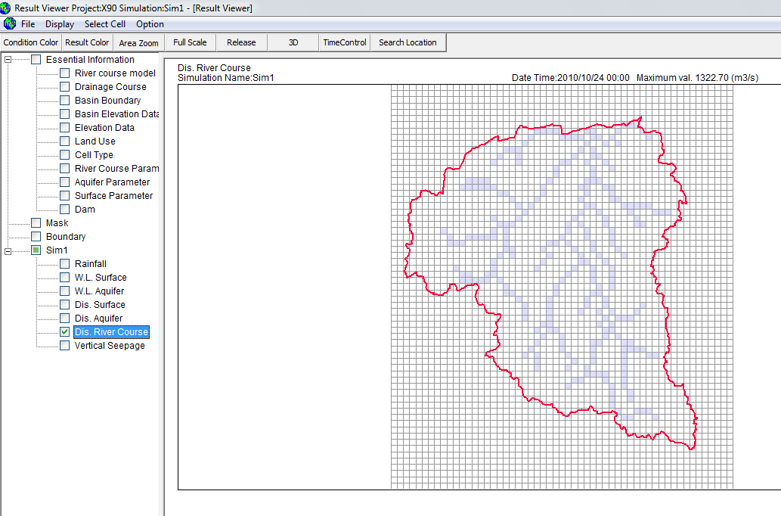
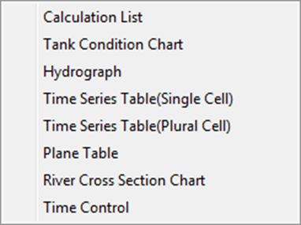
Result Viewer

Slide 18
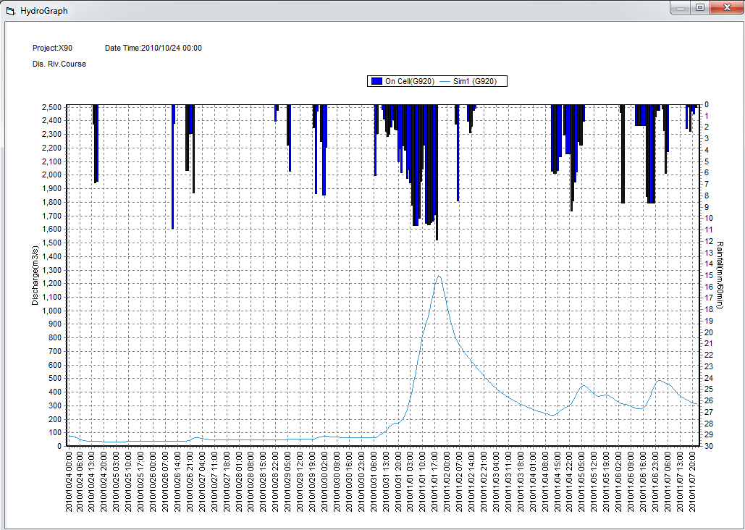
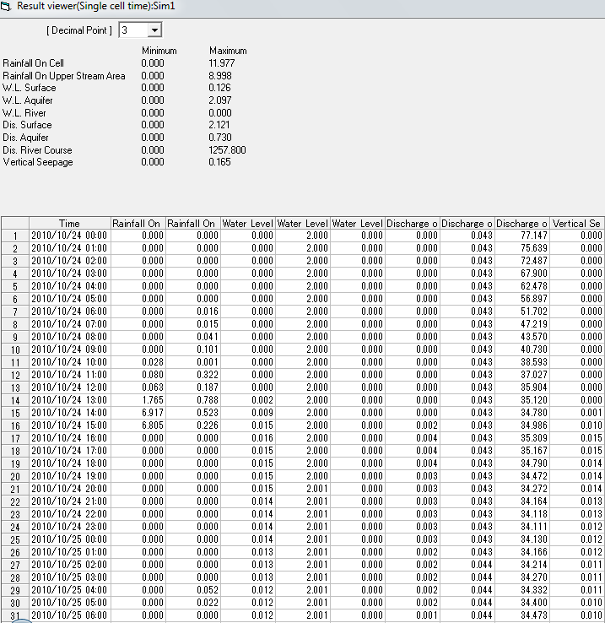
Result Viewer

